Slide 1

Unit - 3
Financial Management

Slide 2
Table of Contents
Definition
Introduction
Importance of Financial Management
Scope of Financial Management
Functions of Financial Management
Objectives of Financial Management
Financial Planning
2
Notes:
SAY: Before we wrap up the course, let’s review what we have learned today.
During this course, we have
<READ the bullets from the slide.>
GO to next slide.

Slide 3

Definition
Financial Management means planning, organizing, directing, and controlling the financial activities such as procurement and utilization of funds of the enterprise. It means applying general management principles to the financial resources of the enterprise.
According to Weston Brigham, “Financial Management is an area of financial decision making, harmonizing individual motives and enterprise goals.”
3
Notes:
SAY: Before we wrap up the course, let’s review what we have learned today.
During this course, we have
<READ the bullets from the slide.>
GO to next slide.

Slide 4
Introduction
Financial management professionals plan, organize, and control all transactions in a business. They focus on sourcing the capital, whether it is from the initial investment by the entrepreneur, debt financing, venture funding, public issue, or any other sources.
Financial management professionals are also responsible for fund allocation in an optimized way to ensure greater financial stability and growth for the organization.
4
Notes:
SAY: Before we wrap up the course, let’s review what we have learned today.
During this course, we have
<READ the bullets from the slide.>
GO to next slide.

Slide 5

Importance of Financial Management
Notes:
SAY:
The purpose of epidemiology in public health practice is to
discover the agent, host, and environmental factors that affect health;
determine the relative importance of causes of illness, disability, and death;
identify those segments of the population that have the greatest risk from specific causes of ill health; and
evaluate the effectiveness of health programs and services in improving population health.
GO to next slide.

Slide 6
The financial management of an organization determines the objectives, formulate the policies, lay out the procedures, implement the programmes, and allocates the budget related to all financial activities of a business.
Availability of sufficient funds
Maintaining a balance between income and expenses to ensure financial stability
Ensuring efficient and high ROI
Creating and executing business growth and expansion plans
Safeguarding the organization against market uncertainties through ensuring buffer funds
Notes:
SAY:
The purpose of epidemiology in public health practice is to
discover the agent, host, and environmental factors that affect health;
determine the relative importance of causes of illness, disability, and death;
identify those segments of the population that have the greatest risk from specific causes of ill health; and
evaluate the effectiveness of health programs and services in improving population health.
GO to next slide.

Slide 7
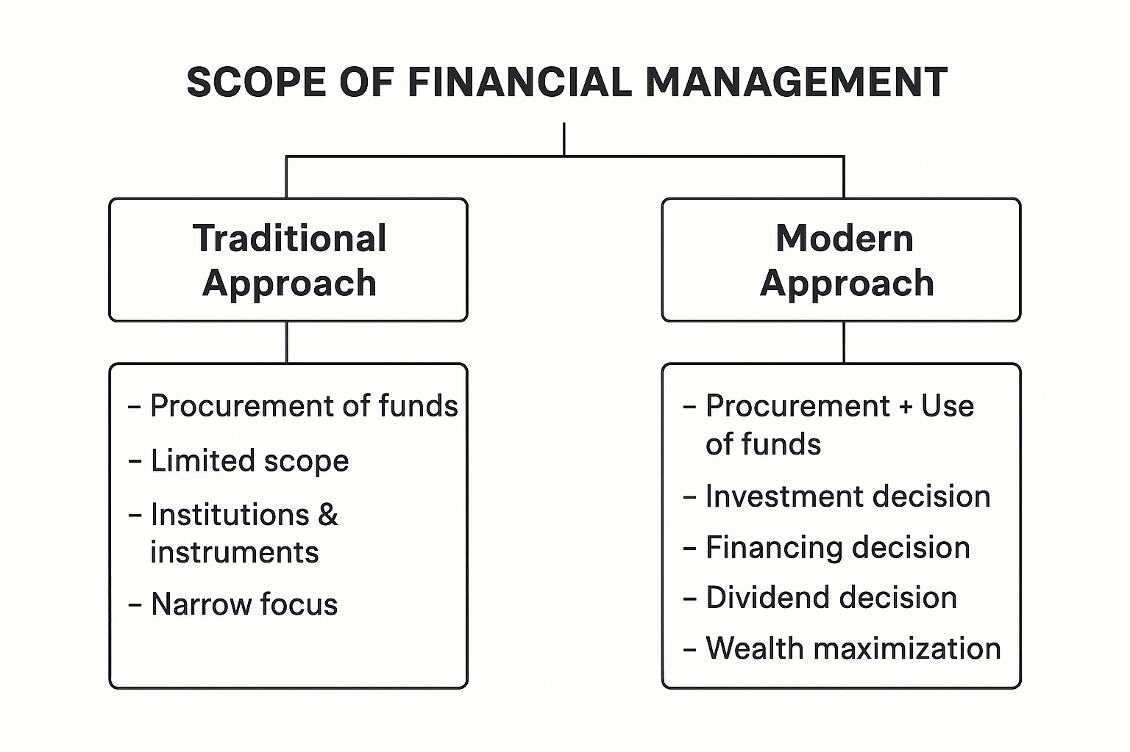
Scope of Financial Management
The Scope and functions of financial management are classified into two categories. These are :
Traditional Approach
Modern Approach
Notes:
SAY:
The purpose of epidemiology in public health practice is to
discover the agent, host, and environmental factors that affect health;
determine the relative importance of causes of illness, disability, and death;
identify those segments of the population that have the greatest risk from specific causes of ill health; and
evaluate the effectiveness of health programs and services in improving population health.
GO to next slide.

Slide 8
Traditional Approach
According to this approach, the scope of the finance function is restricted to “procurement of funds by corporate enterprise to meet their financial needs. In this, the funds could be raised from the combination of the available sources.
The term ‘procurement’ refers to the raising of funds externally as well as the interrelated aspects of raising funds.

Slide 9
Limitations of Traditional Approach
This approach only focuses on procurement of funds.
It deals only with outsiders i.e. investors, investment bankers, etc.
It fails to consider an important aspect i.e. allocation of funds.
It also fails to consider the problem involved in working problem management.
The internal decision making is completely ignored in this approach.

Slide 10
Modern Approach
The modern approach is an analytical way of looking into the financial problems of the firm.
According to this approach, the finance function covers both acquisition of funda as well as the allocation of funds to various uses.
The main contents of modern approach are :
How long should an enterprise be, how fast it should grow.
In what form should it hold assets.
What should be the composition of its liabilities.

Slide 11
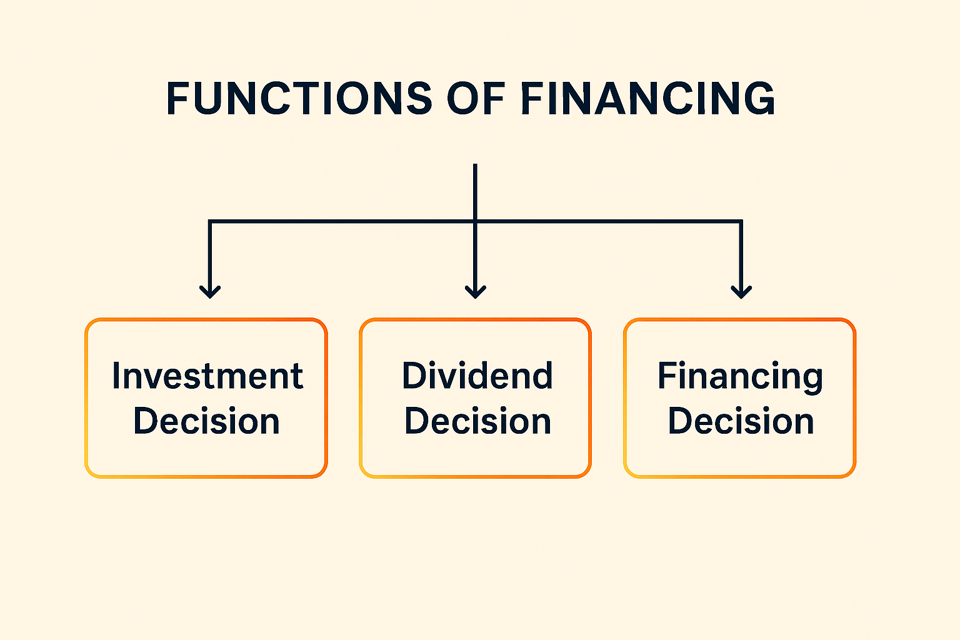
Functions of Finance Under Modern Approach

Slide 12
Investment Decision
Investment decisions relate to the selection of assets in which funds will be invested by a firm. The assets which can be acquired by the firm can be divided into two broad categories:
Long-term assets (which yield return over a period of time in the future) – Capital Budgeting
Short-term or Current assets (converted into cash within one year) – Working Capital Management
Notes:
SAY:
The purpose of epidemiology in public health practice is to
discover the agent, host, and environmental factors that affect health;
determine the relative importance of causes of illness, disability, and death;
identify those segments of the population that have the greatest risk from specific causes of ill health; and
evaluate the effectiveness of health programs and services in improving population health.
GO to next slide.

Slide 13
Financing Decision
A Financing Decision refers to the choice a firm makes about how to raise funds for its operations and investments. It deals with the capital structure, where the mix of debt and equity is used by the firm.
Determination of the proportion of equity and debt is the main issue in financing decision. Once the best combination of debt and equity is determined, only then the next step of raising an appropriate amount through available sources be started.

Slide 14
Dividend Decision
The dividend should be analysed in relation to the financing decision of the firm. Two alternatives are available in dealing with the profits of a firm:
They can be distributed to the shareholders in the form of dividends
They can be retained in the business itself.
The decision as to which course should be followed depends mainly on the significant dividend decision, the dividend–pay–out ratio, i.e., what proportion of net profits should be paid out to the shareholders.

Slide 15
Objectives of Financial Management
The term ‘objective’ refers to a goal or decision for optimum financial decision-making. They are concerned with designing a method of operating the internal investment and financing of a firm.
There are two widely discussed approaches under this, these are:
Profit Maximisation
Wealth Maximisation
Notes:
SAY:
The purpose of epidemiology in public health practice is to
discover the agent, host, and environmental factors that affect health;
determine the relative importance of causes of illness, disability, and death;
identify those segments of the population that have the greatest risk from specific causes of ill health; and
evaluate the effectiveness of health programs and services in improving population health.
GO to next slide.

Slide 16
Profit Maximisation
Profit maximization is the traditional objective of financial management. It means earning the maximum possible profit in the short term by increasing revenues and reducing costs. However, it ignores long-term growth, risk, and the welfare of stakeholders.
The firm should undertake those actions that would increase profits and drop those actions that would decrease profits, as the financial decisions of the firm should be oriented to the maximisation of profits.
Profit provides the yardstick for measuring the performance of a firm.
Notes:
SAY:
The purpose of epidemiology in public health practice is to
discover the agent, host, and environmental factors that affect health;
determine the relative importance of causes of illness, disability, and death;
identify those segments of the population that have the greatest risk from specific causes of ill health; and
evaluate the effectiveness of health programs and services in improving population health.
GO to next slide.

Slide 17
Wealth Maximisation
Wealth maximization is the modern and primary objective of financial management. It means increasing the overall value of the business so that the net worth of shareholders grows over time.
Unlike profit maximization, which looks at short-term gains, wealth maximization focuses on the long-term growth, sustainability, and market value of the company. It considers factors like cash flows, risk, return, and investment decisions, ensuring that the firm is financially strong and competitive in the future.

Slide 18
Financial Planning
Financial planning is the process of estimating how much money a business will need and determining the best ways to use and manage those funds. It involves setting financial goals, forecasting income and expenses, and preparing strategies for investment, financing, and cash flow management.
The basic purpose of financial planning is to ensure that adequate funds are available at the right time, avoid shortages or surpluses, and make proper use of resources. It also helps in reducing uncertainty, guiding decision-making, and supporting the long-term growth and stability of the business.
Notes:
SAY:
The purpose of epidemiology in public health practice is to
discover the agent, host, and environmental factors that affect health;
determine the relative importance of causes of illness, disability, and death;
identify those segments of the population that have the greatest risk from specific causes of ill health; and
evaluate the effectiveness of health programs and services in improving population health.
GO to next slide.

